Slide 1

Smart Home System

Slide 2
Objectives
This project implements a simplified HVAC control system using an embedded microcontroller.
The main goals were to:
Detect environmental motion using a PIR sensor
Control heating and cooling indicators using LEDs
Demonstrate real-time scheduling using FreeRTOS
Use interrupts and queues for event-driven processing
Provide live system debugging via UART logging

Slide 3
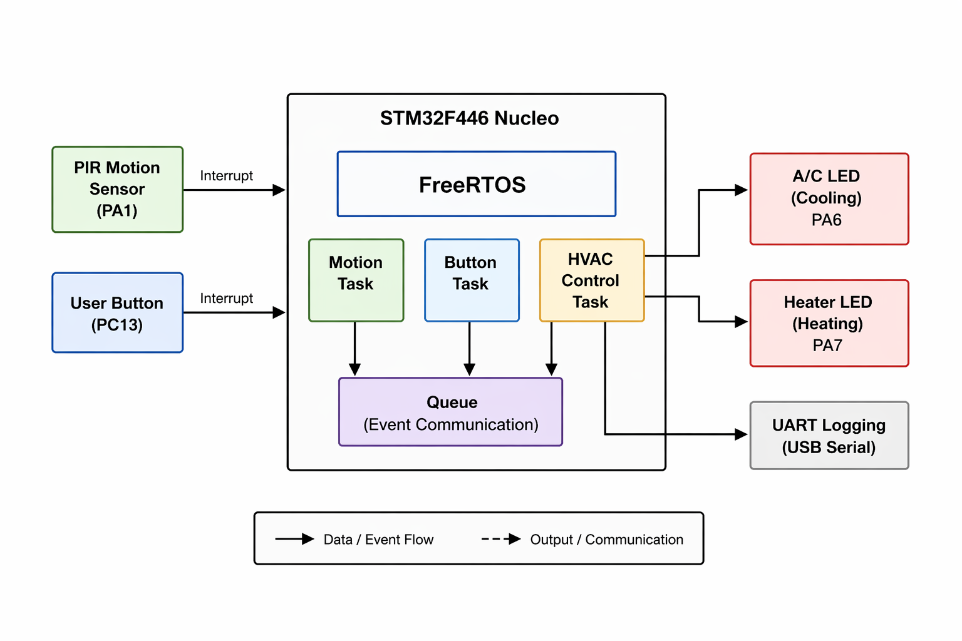
System Overview

Slide 4
Materials needed
Motion Sensor (Detects motion)
2 LEDs (One for heating, one for cooling)
Nucleo F446RE board
Breadboard
Wires
USB Cord

Slide 5
Wiring/GPIO mapping
All peripherals are connected through GPIO pins:
PIR sensor output → PA1 (external interrupt)
A/C LED → PA6 (GPIO output)
Heater LED → PA7 (GPIO output)
User button → PC13 (external interrupt)
LEDs include 220Ω resistors to limit current and protect GPIO pins. UART communication uses the onboard ST-Link USB interface (PA2 TX internally routed).

Slide 6
FreeRTOS
The system is structured using FreeRTOS to manage concurrency:
Motion Task → processes PIR sensor events
Button Task → handles user input events
HVAC Control Task → determines system state and updates outputs
A FreeRTOS queue is used to safely pass events between interrupt context and tasks, ensuring deterministic execution and avoiding race conditions.

Slide 7
Interrupts
The system is fully interrupt-driven:
PIR sensor or button triggers a GPIO interrupt
Interrupt Service Routine (ISR) executes minimal logic
Event is pushed into a FreeRTOS queue
HVAC control task consumes event
System state is updated immediately (Heating or Cooling)
This design ensures low latency and real-time responsiveness.

Slide 8
UART and PuTTY
UART is used for real-time system observability:
Baud rate: 115200
Outputs include:
Motion detected / cleared
HVAC state transitions
Button press events
Task-level execution logs
This acts as a lightweight debugging and validation tool without needing external debugging hardware.

Slide 9
Results
The system performed reliably during testing:
Motion detection triggered immediate HVAC mode switching
LEDs accurately reflected system state (Heat vs Cool)
Button input successfully toggled system behavior
No noticeable task blocking or missed events
UART logs confirmed correct event sequencing and timing
The system demonstrates predictable real-time behavior under FreeRTOS scheduling.

